Slide 1
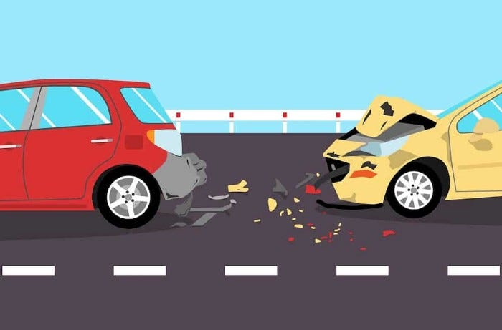
ACCIDENT SEVERITY DETECTION

Slide 2
Abstract
Timely and accurate detection of traffic incidents can effectively reduce personal casualties and property losses, and improve the ability of macro-control and scientific decision making of traffic. The unbalance of traffic incident data has a great influence on the detection effect. Therefore, a traffic incident detection method based on factor analysis and weighted random forest (FA-WRF) is designed.
Through the analysis of the change rule of traffic flow parameters to build the initial incident variable. The factor analysis (FA) method is used to reduce the dimension of the initial incident variables. Using Bootstrap improved algorithm to predetermine the data extraction standard of the training set.
The MCC coefficient value is calculated for the classification effect of the decision tree after training, and is assigned to each tree as a weight value, so as to ensure that the trees with better classification ability have more voting power in the voting process, thus improve the overall classification performance of the random forest (RF) algorithm for unbalanced data.
The detection performance is evaluated by the common criteria including the detection rate, the false alarm rate, the classification rate and the area under the curve of the receiver operating characteristic. The experimental results indicate that the model based on FA-WRF has the better classification effect. Meanwhile it is competitive in processing unbalanced data classification compared with Support Vector Machine.

Slide 3
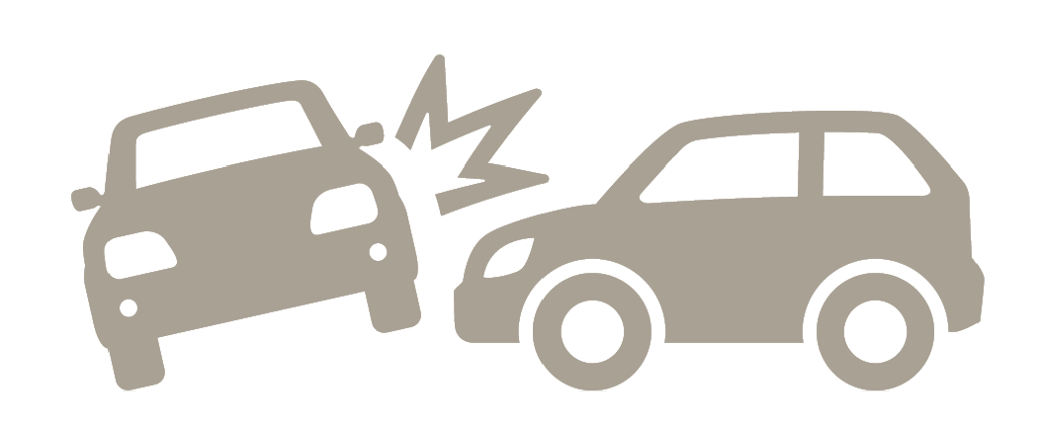
INTRODUCTION
The diversity of the accident severity (it can be high, serious, or minor) can be determined by the injury severity for the most severe injuries casualness, the police store these kinds of these details very soon after the occurrence of the accidents.
If further data is present that can update the divination (like if the individual dies within 30 days of the accident) then the police will change the first classification of the severity.
The main aim of this assignment is to determine the accidental severeness trading and whether the rating will be the highest or fatal. for this, it has been used random forest, logistic regression, and support vector machine divination techniques. Road accidents are a severe cause that can decrease the expectancy rate

Slide 4

DATASET
The dataset is taken from the Kaggle.
The dataset contains details about accidents in US from 2016 to 2021. The data is collected through various sources and is thus combined to form a single dataset. It has more than 2.8 million rows and has 47 columns.
The target column in the dataset has four types of labels labelled as 0,1,2 and 3. The labels represents the severity of the accidents. The label 1 and 2 are merged to label 1 while label 3 is changed to label 2.
This is done to convert the four labelled dataset into 3 labelled dataset. The columns in the dataset represents the details of an accident and its severity.

Slide 5
TECHNIQUES USED
Bootstrapping in machine learning In order to calculate the uncertainty of a statistical estimator, bootstrapping is a replication approach utilised in machine learning. In order to build new datasets from the original dataset that can subsequently be used to train various models, this method entails creating additional samples using the initial dataset using replacement
Classification report A classification report is a tool for assessing how well a machine learning model performs when it comes to classification tasks. For every category in the information set, it gives a summary of the precision, recall, F1 score, and support.
Recall and precision In the context of information retrieval or text classification tasks, recall and precision are two crucial measures used to assess the effectiveness of a classification model. In practise, it’s common to want to strike a compromise between recall and accuracy

Slide 6
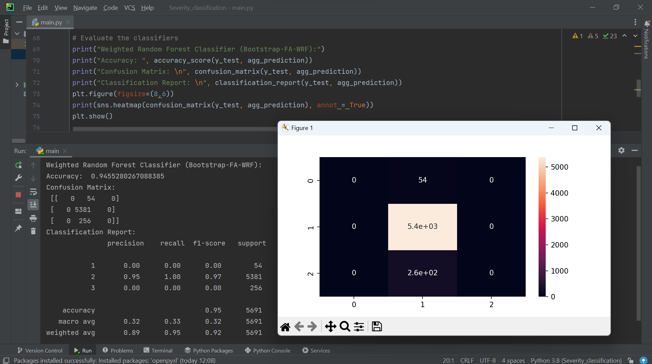
METHODS AND RESULTS
Factor analysis
A statistical technique called factor analysis is utilised to examine the connections between a lot of different variables and pinpoint the underlying causes that underlie the patterns of these variables. In order to determine the factors that account for the most variance in the data, factor analysis first determines the correlation matrix between the variables.
To make the elements easier to understand and to make the underlying linkages more obvious, the components are frequently rotated.
The figure represents the performance of the weighted random forest model. Performance is measures using accuracy and classification report of the model. Accuracy of the model is calculated using ‘accuracy score’ function.
The accuracy is calculated using predicted and actual values. FA-WRF model is build with major step: bootstrapping, factor analysis and then weighted random forest.

Slide 7
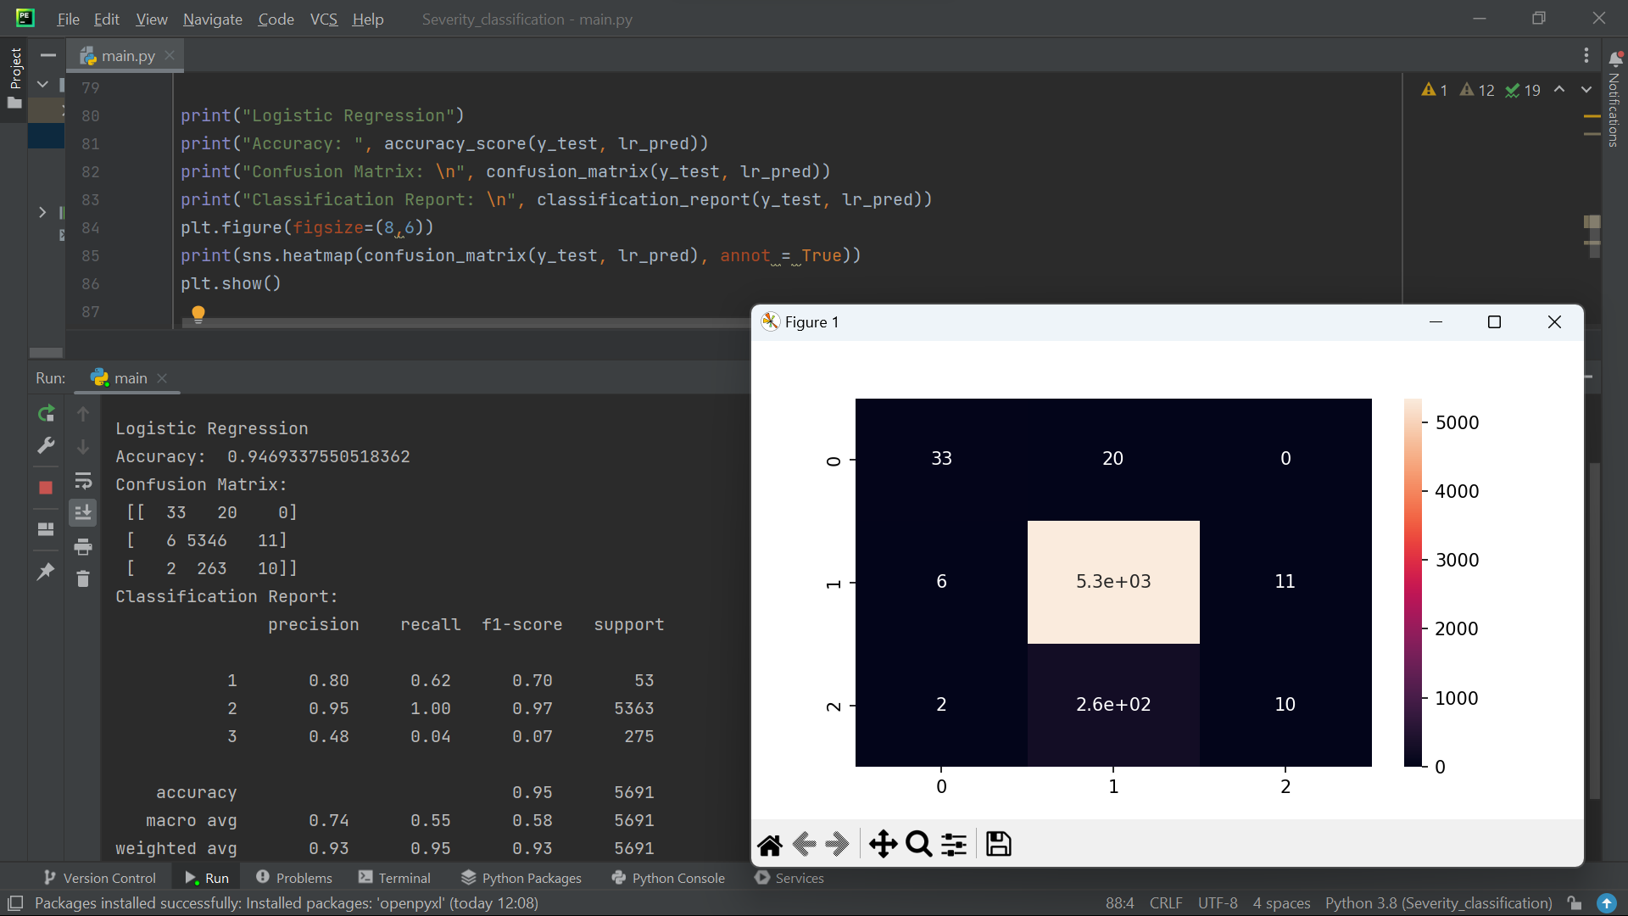
Logistic regression
For binary categorization applications, logistic regression is a frequently used and easily comprehended technique. In comparison to other methods of categorization, it offers a number of benefits, including brevity, comprehension, and support for both continuous and categorical predictor variables.
The above figure represents, the model performance of Logistic Regression. This model is a sigmoid function and is used to classify the values into the categories. The model is used to classify the labels into three categories. The accuracy score of the model is observed to be 0.9469.

Slide 8
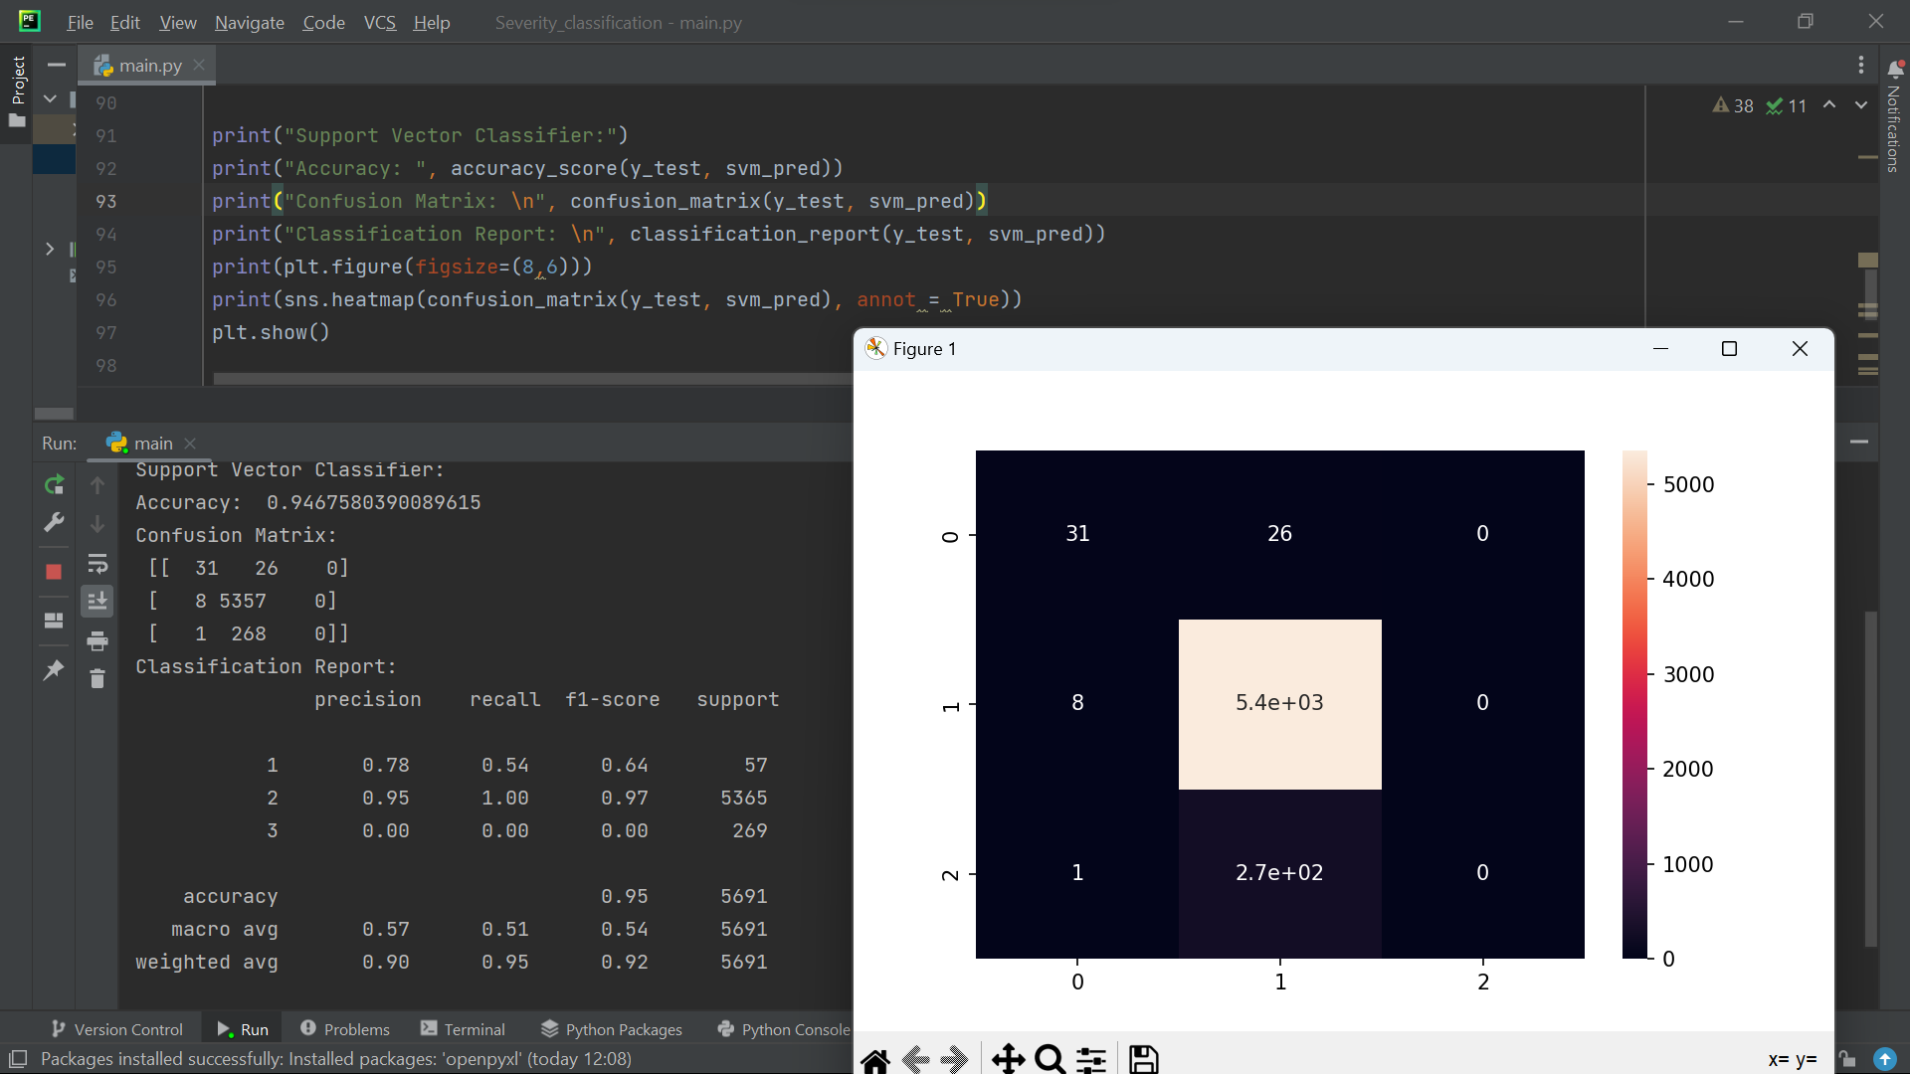
Support vector machine
Popular supervised learning algorithms used in machine learning and data mining include Support Vector Machine (SVM). By locating the optimal border (or hyperplane) that maximises the margin between the two classes, it is a sort of binary linear classification algorithm that divides the information points into two distinct groups [3].
The above figure represents the model building and performance of support vector machines. Support vector machines can be used for classification as well regression problems. The accuracy score of this model is 0.9467. As per the accuracy score, the model performed well but as per its confusion matrix it is observable that it failed to detect label 3 values.

Slide 9
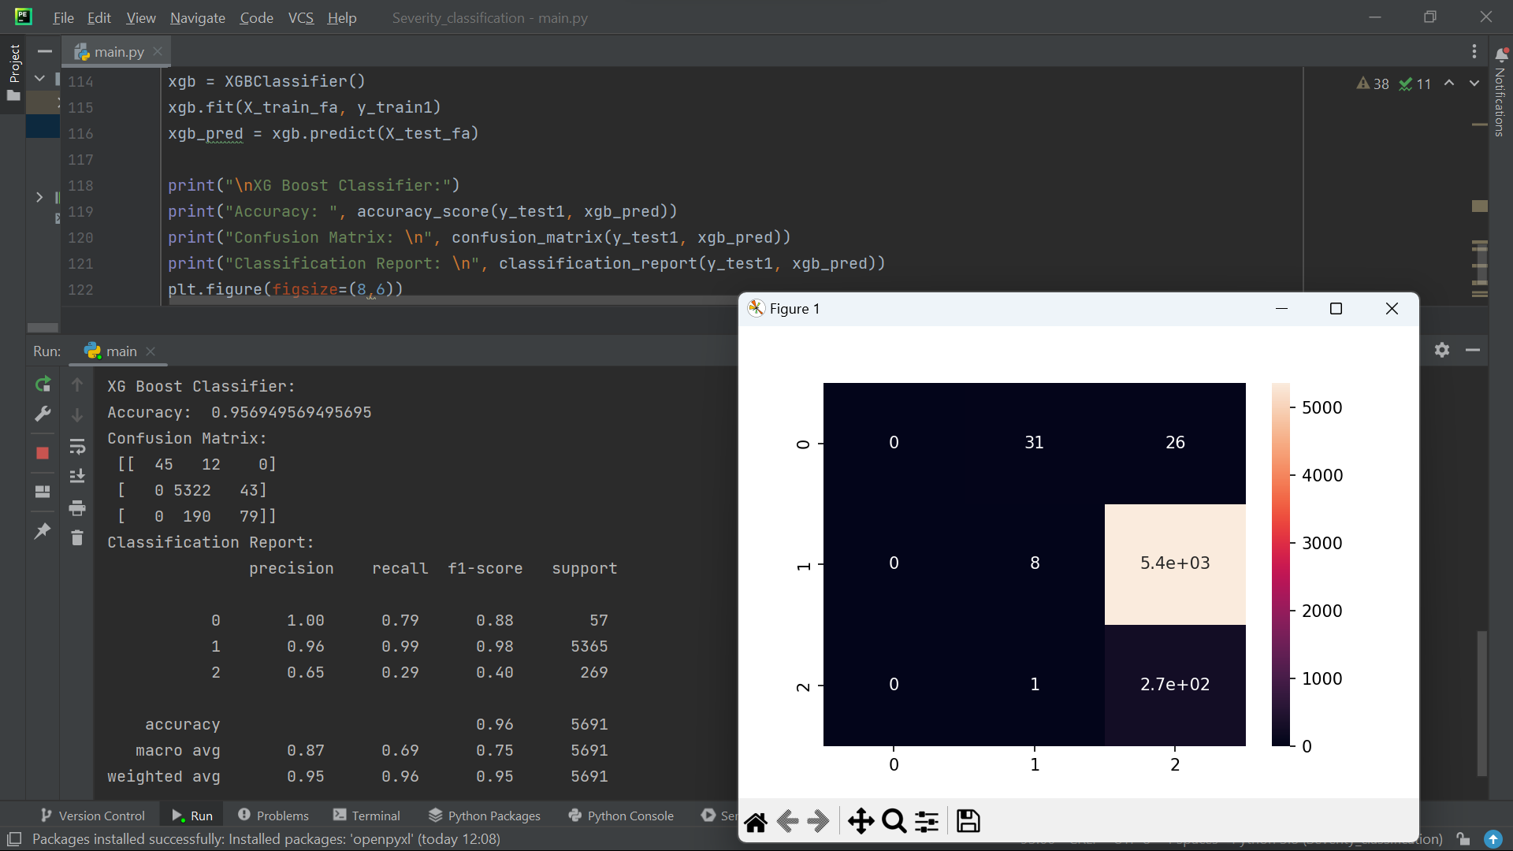
XG BOOST well-liked and effective machine learning technique for classification, regression, and ranking issues. It is a kind of gradient boosting algorithm that boosts prediction accuracy by combining gradient boosting methods with decision trees. Scalability, rapid implementation, and outstanding performance on a variety of issues are all attributes of XGBoost.
Gradient boost is a method that iteratively enhances the model's performance by adding new decision trees that fix the flaws in the old ones. Extreme gradient boost algorithm is also used for the classification. The marking of the labels is changed for this algorithm

Slide 10

DISCUSSIONS AND LIMITATIONS
The paper proposes a traffic incident detection method based on factor analysis and weighted random forest (FA-WRF).
The unbalance of traffic incident data can affect the detection performance, so the model is designed to handle unbalanced data.
The model is evaluated using common criteria, including the detection rate, false alarm rate, classification rate, and area under the curve of the receiver operating characteristic.
The related works section discusses several studies that used machine learning algorithms, such as SVM, Random Forest, and Gradient Boosting, to predict accident severity and improve road safety.
Traffic accidents are a major public health concern that can cause personal casualties and property losses, and advanced machine learning algorithms can help mitigate the severity of accidents

Slide 11
CONCLUSION
Accident detection can be really helpful in reducing the property loss and personal losses. The accident detection severity is labelled in three categories slightly injured, medium severity and fatally injured.
This detection will help in prioritizing the cases that have higher severity. Machine learning algorithms are used in-order to detect the severity of these cases. Since the dataset are mostly unbalanced and hence it is important to build models that can handle unbalanced data.
The models used for detection are factor analysis weighted random forest after bootstrapping the data, logistic regression, support vector machine and extreme gradient descent algorithm.
The data is bootstrapped and resampled many times then factor analysis is performed. The factor analysis method reduces the dimensions of the data. The number of features is decided and then the dataset is reduced and highest weighted features are kept.
Other models are also trained and used to make predictions but on regular split of dataset into training and testing and not on bootstrapped data. After making predictions, models are evaluated using classification report and accuracy score.
It was observed that extreme gradient boost algorithm performed the best in terms of accuracy as well as classification report. The model was able to correctly classify the values into their respective categories with 95.69

Slide 12

THANKYOU

